Slide 1
Virtual Exhibit Hall

Slide 2
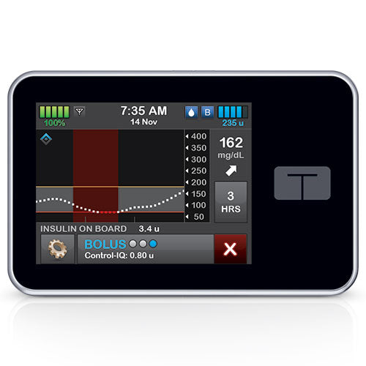
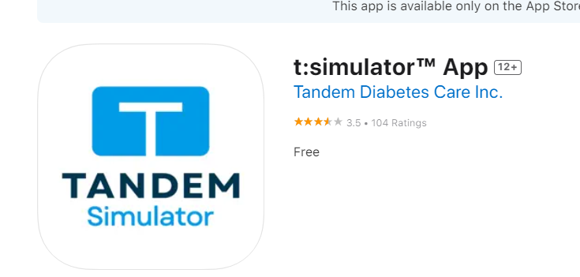
Tandem Insulin Pump
Download the T:Simulator App and choose Control IQ to get a virtual pump on your phone to play with the buttons and settings.

Slide 3
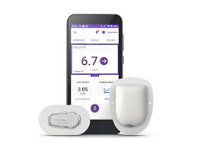
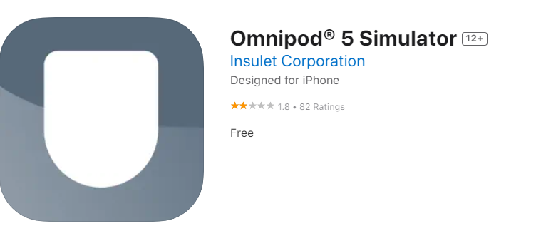
Omnipod 5 Insulin Pump
Download the Omnipod 5 simulator app to practice using the controller

Slide 4

Medtronic Insulin Pumps
780G Virtual Pump at this website
https://www.medtronicdiabetes.com/minimed-virtual-pump
Virtual pump app

Slide 5
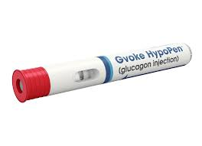
Gvoke Hypo Pen
Video on how to use
https://www.youtube.com/watch?v=A9BwCV67PUE
Handout
https://www.gvokeglucagon.com/wp-content/uploads/2023/07/gvoke-hypopen-digital-quick-guide.pdf

Slide 6


Baqsimi
How to administer glucagon intranasally Check out this handout
https://pi.lilly.com/us/baqsimi-us-ifu.pdf

Slide 7
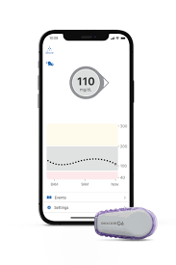
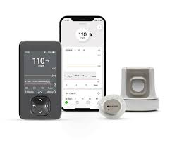
Dexcom G6 and G7 Tutorials
Dexcom G6 https://www.dexcom.com/en-us/tutorials
Dexcom G7 https://www.dexcom.com/en-us/training-videos

Slide 8

Freestyle Libre
Tutorial videos found here:
https://www.freestyle.abbott/us-en/support.html

Slide 9
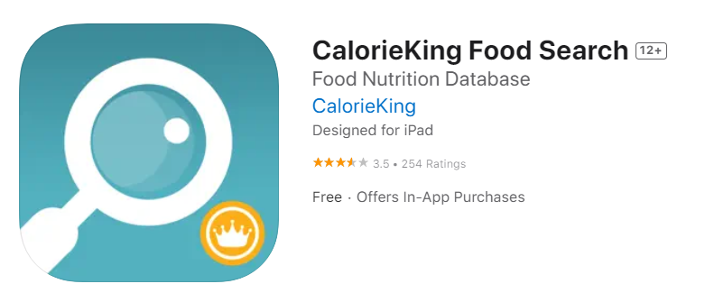
Carbohydrate Counting Resources
Calorie King App

