Slide 1
Insulin Pump Therapy

Slide 2
Objectives
The learner will be able to:
Describe how the insulin pump works
Discuss the integration of pumps and cgm(continuous glucose monitoring (hybrid closed loop systems)
Problem solve issues that can occur with the insulin pump
Name 3 things that can go wrong with the insulin pump system resulting in high blood sugars

Slide 3
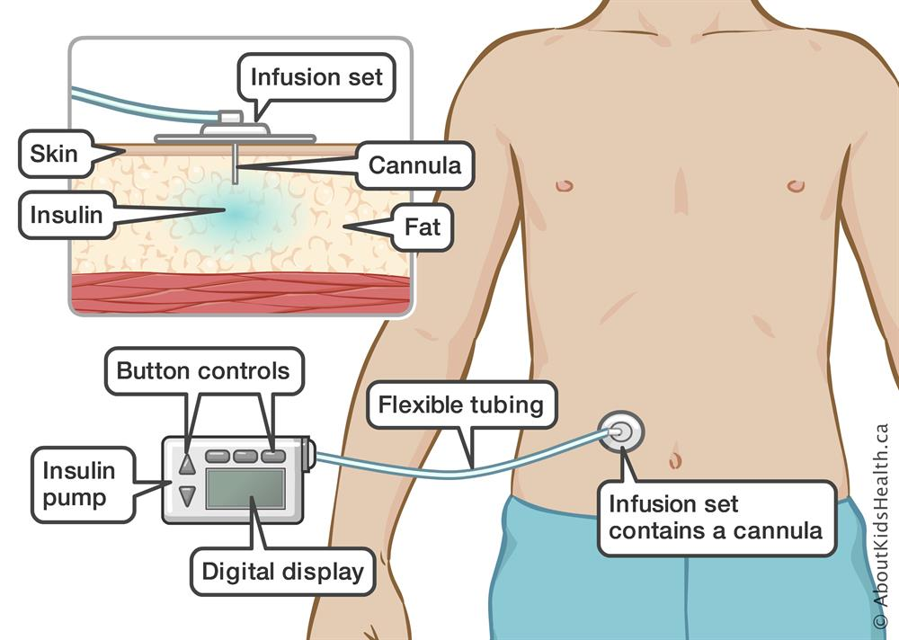
Basics
An insulin pump is a device that provides small amounts of fast-acting insulin (basal) every few minutes through a small catheter under the skin.
The student then takes an additional amount of insulin doses (boluses) through the pump for meals and snacks
Uses only rapid acting insulin (Humalog or Novolog)

Slide 4
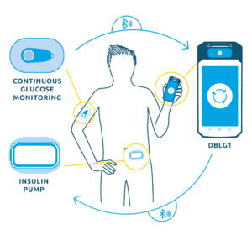
What is an AID?
Automated insulin delivery (AID) is a way of delivering insulin through an insulin pump that communicates with a continuous glucose monitor (CGM). This is also known as a hybrid closed loop (HCL) system
They work a bit differently but all trying to keep blood sugar around 120mg/dL

Slide 5
What we are seeing with hybrid closed loop systems
Lower A1c
Decreased diabetes burden
More independence and ability for child to be away from their parent
Less severe low blood sugar
Improved sleep
Ability for clinicians to see how much insulin is being delivered to support patients

Slide 6
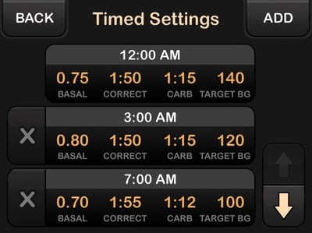
Insulin Pump Settings

Slide 7
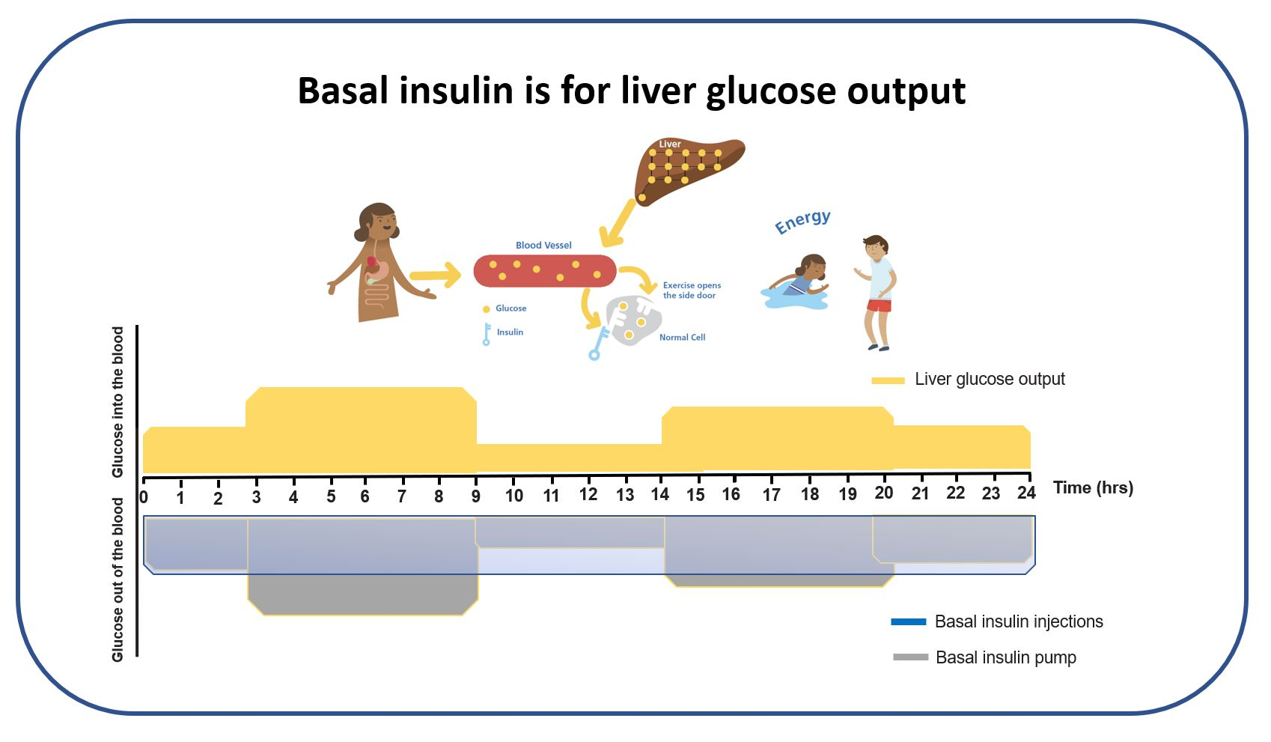
Basal Rates
May have different needs at different times
Should keep blood sugar steady
Replaces long-lasting insulin
Some pumps don’t use this setting unless it is not in automated mode

Slide 8
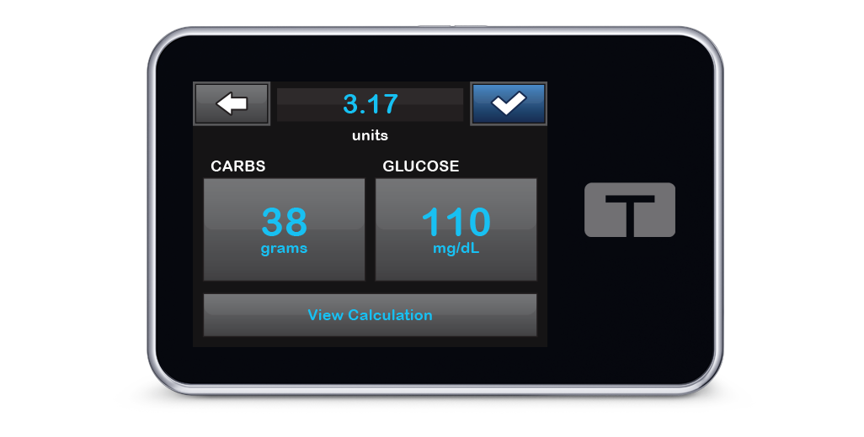
Insulin: Carbohydrate ratio
This setting is managing carbohydrates eaten.
Many need different ratios for different meals
Examples
More aggressive for breakfast
Conservative at lunch with increased activity
Pumper simply enters carbs and the pump calculates dose

Slide 9
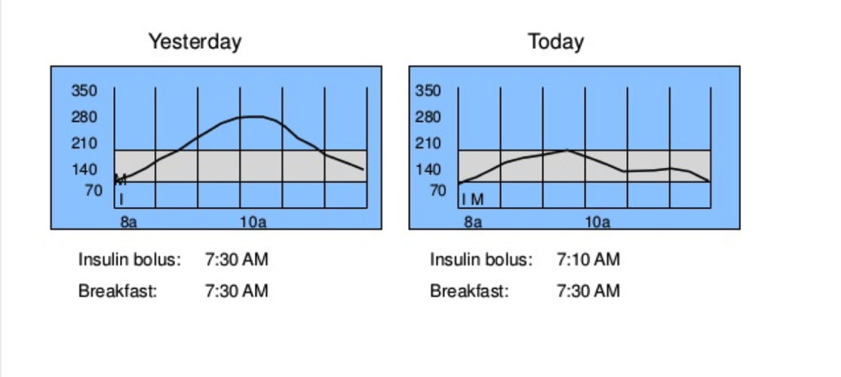
Bolus in advance of the carbs, especially with AID
Notes:
Who does this – who does that, this is the single MOST important strategy to keep your blood sugar normal. Higher the amount of carb, the bigger the dose, the earlier you need to bolus

Slide 10
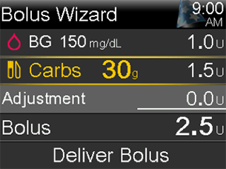
Correction or sensitivity factor
Manages high blood sugars
Set as how many points does one unit of insulin drop blood sugar.
If high blood sugars do not come back to target in 3 hours this setting may need to be changed

Slide 11
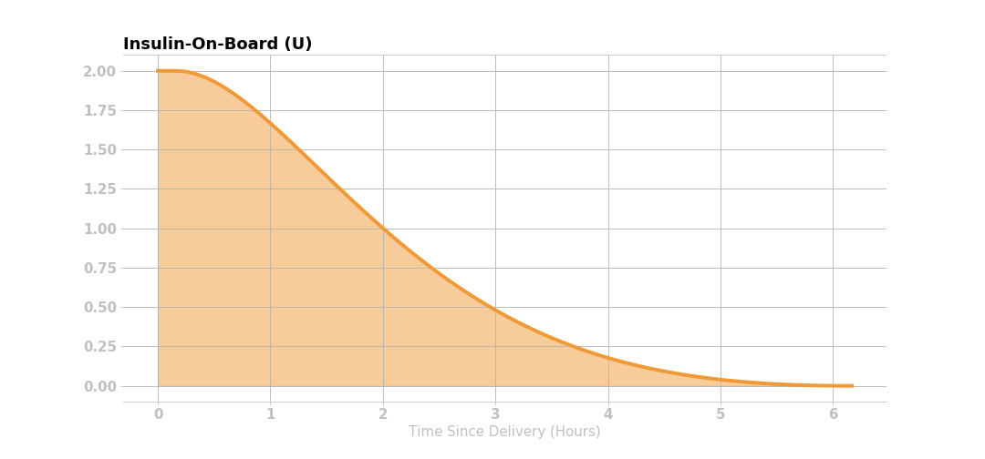
Insulin on board
This is basically insulin that is left over from the last bolus THAT IS STILL WORKING
To prevent insulin stacking the pump will recommend less correction if there is “bolus insulin on board” Do not override what pump recommending.
Okay to enter high blood sugars to give corrections before insulin has run it’s course
Notes:
Understanding the concept of IOB might help prevent the rage bolusing

Slide 12

Exercise or Activity Mode
Turn this setting on 1-2 hours before activity
Can also be used if you want a higher target when running low.
Most pumps change target to 150mg/dL with exercise mode
Some also reduce background delivery

Slide 13
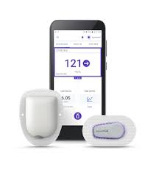
What do I need to know about OMNIPOD 5
Tubeless pump
Consists of two components: the Pod and a smartphone-like Controller/Android phone
The Pod receives insulin delivery instructions from the Controller.
Pod stays attached for up to 3 days
Waterproof
Need phone to manage Dexcom
If not bolusing could go out of automated mode

Slide 14
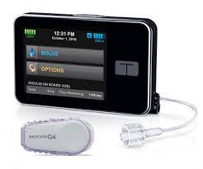
What do I need to know about Tandem TSlim
Needs to be charged
Stays in control IQ unless Dexcom not working
Does automatic corrections at 60%
Tubing change every 3 days
Has an app that one can bolus from their phone

Slide 15
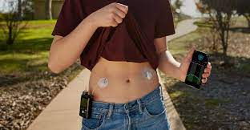
What do I need to know about Medtronic pumps
Use the Medtronic Guardian sensor
Takes AAA batteries
Auto corrections in 780G, more aggressive
Can have auto mode exits with high blood sugars (770G)
Only pump that has 7 day infusion set

Slide 16
Insulin Pump Problems

Slide 17
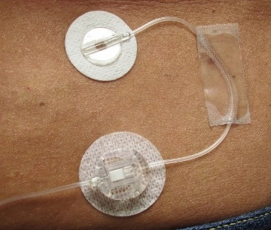
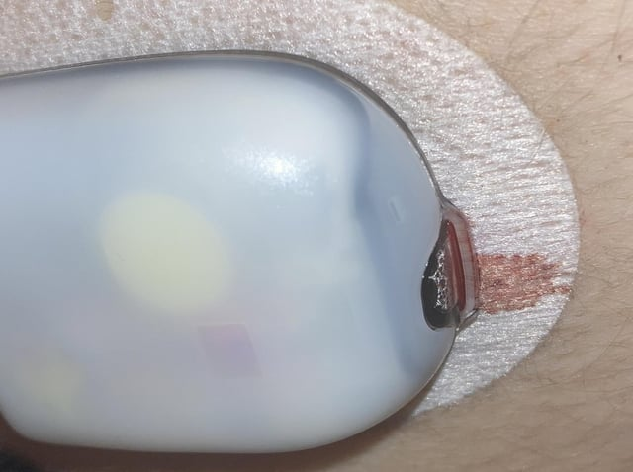
Infusion Site Issues
Site could get kinked or come out
Can start to make ketones quickly resulting in nausea and sometimes vomiting

Slide 18
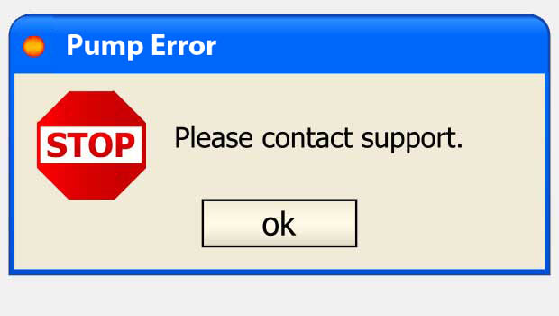
The pump malfunctions
Give fast acting insulin every 3 hours by injection (add up missed basal rate and include as needed for food and blood sugar)
OR
Start long-acting insulin
Look at basal total for the day and give as long-lasting.
Use fast-acting insulin for meal bolus and/or correction just like before the pump!

Slide 19
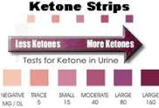
Test for ketones with every unexplained blood sugar >300
NEGATIVE
POSITIVE
(not trace or small)
Give a bolus of insulin via the insulin pump and avoid any carbs
Monitor blood sugar for the next one-two hours
If blood sugar is not decreasing, change infusion set.
Test ketones in 3 hours
Give a shot of insulin
Why? How much?
Change infusion set
Drink water
Monitor blood sugar for the next hour
When would you call MD?

Slide 20
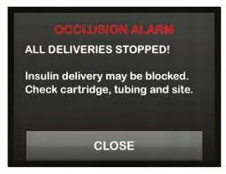
Other Pump Issues
Pump battery dies/needs to be charged
Pump runs out of insulin
Pumper runs out of supplies for Dexcom or insulin pump and has to go back to injections
Dexcom not working
Bad insulin
Air in tubing
Occlusion
Not bolusing

Slide 21

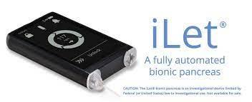
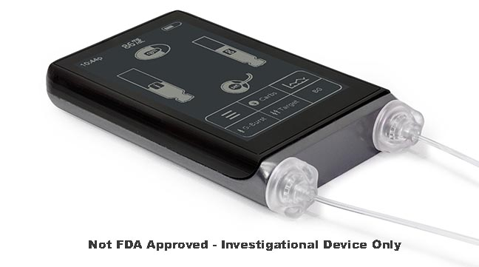
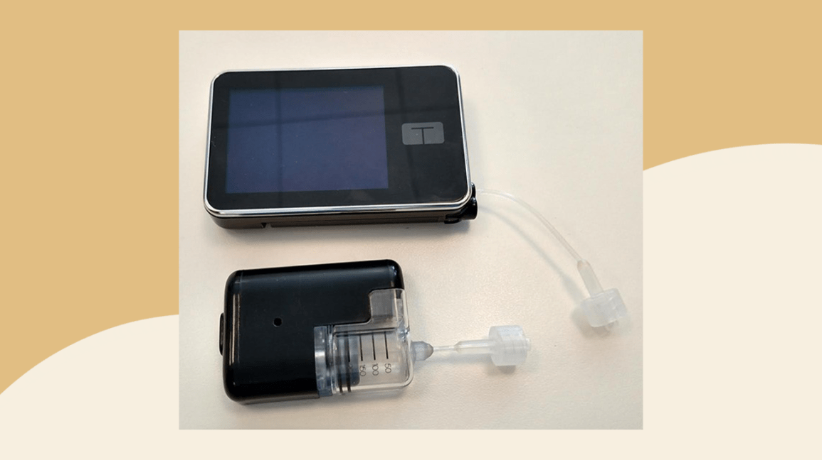
Future insulin pumps technology

Slide 22


Questions?

