Slide 1
Nutrition in Today’s World
Erin Love, RD

Slide 2
Topics
What is a carbohydrate and why does it matter?
Carbohydrate counting
Other factors that affect glycemic patterns
  Other nutrients
  Timing
  Snacks

Slide 3
Standards of Care in Diabetes 2023
14.2 Individualized medical nutrition therapy is recommended for youth with type 1 diabetes as an essential component of the overall treatment plan
14.3 Monitoring carbohydrate intake, whether by carbohydrate counting or experience based estimation, is a key component to optimizing glycemic management
14.59 Nutrition for youth with prediabetes and type 2 diabetes, like for all children and adolescents, should focus on healthy eating patterns that emphasize consumption of nutrient-dense, high-quality foods and decreased consumption of calorie-dense, nutrient-poor foods, particularly sugar-added beverages
Notes:
I want to start by highlight a few parts from the most recent American diabetes association standards of care in diabetes.
1st 2 points are specifically referring to people with type 1 diabetes
The part I want to emphasize in point 1 is “individualized” – its not “one size fits all”
Monitoring carbs is a key component of glycemic management
For people with type 2 diabetes the focus should be on choosing the most nutrient dense foods and processed and nutrient poor foods.

Slide 4
What is a carbohydrate and why does it matter?

Slide 5
What is a carbohydrate and why does it matter?
Macronutrient
Provides energy in the form of glucose
Has the biggest impact on blood sugars
Requires insulin in order to be used

Slide 6
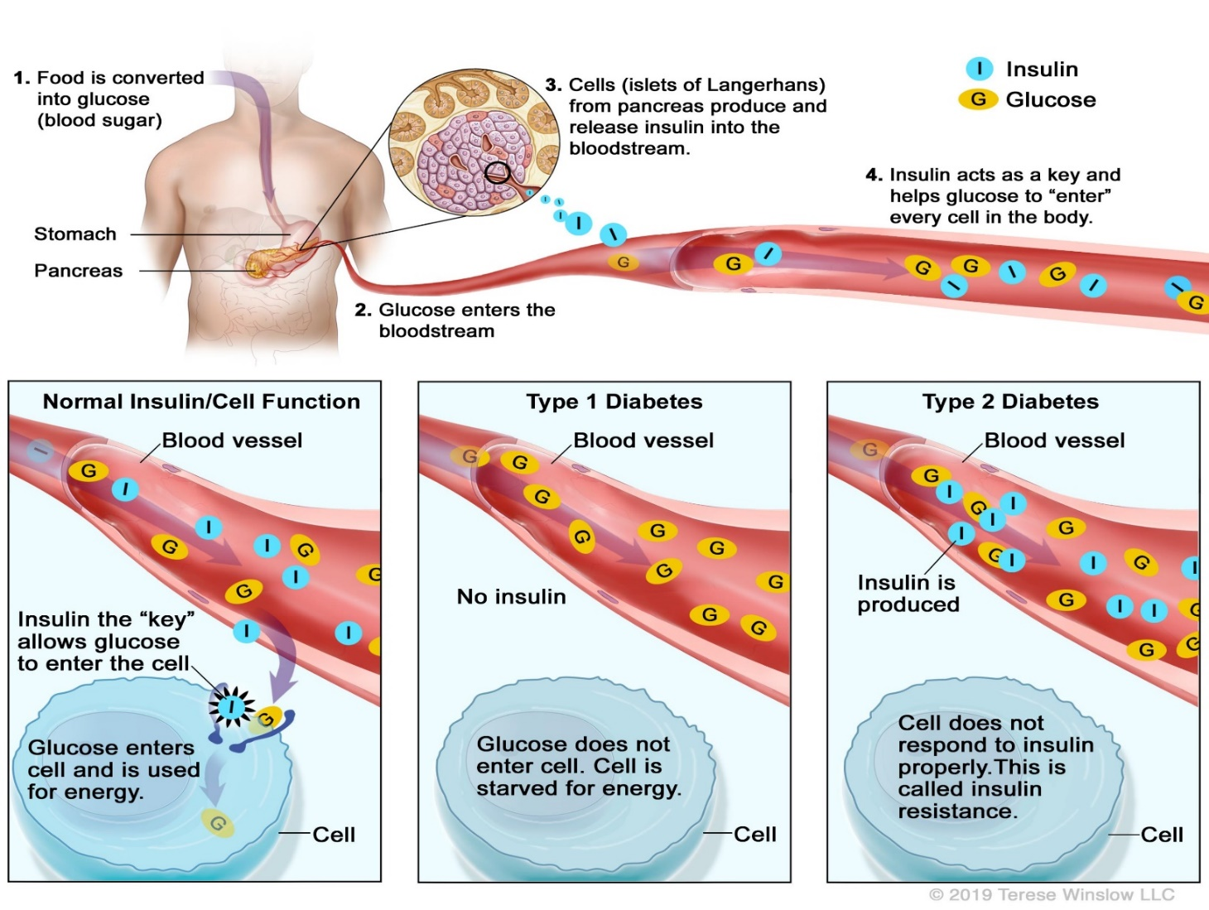
What happens when we eat food?
Notes:
body breaks carbs down into glucose
In someone without diabetes the body then releases insulin in response to the rise in blood sugars
In someone with T1 DM the pancreas no longer makes insulin
In someone with T2 they may have a combination of not producing enough insulin and having insulin resistance

Slide 7
What happens when we eat food?
Notes:
body breaks carbs down into glucose
In someone without diabetes the body then releases insulin in response to the rise in blood sugars
In someone with T1 DM the pancreas no longer makes insulin
In someone with T2 they may have a combination of not producing enough insulin and having insulin resistance

Slide 8
What happens when we eat food?
Notes:
body breaks carbs down into glucose
In someone without diabetes the body then releases insulin in response to the rise in blood sugars
In someone with T1 DM the pancreas no longer makes insulin
In someone with T2 they may have a combination of not producing enough insulin and having insulin resistance

Slide 9
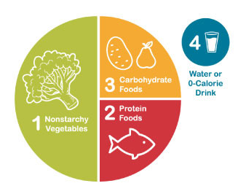
How can we eat to support healthy glycemic management with diabetes?
Healthy/diabetes plate method
Consistent carbohydrate diets
Counting carbohydrates
Insulin
  Set doses
  Insulin to carbohydrate ratio
Notes:
Choosing the right eating plan depends on the type of diabetes and should be individualized based on the persons needs
The diabetes plate method is a visual way of planning a balanced meal that focuses on majority of plate being vegetables and a quarter of the plate being carbs and protein
Consistent cho diets emphasize eating consistent cho throu

Slide 10
How do we count carbohydrates?
Exchange lists
Label reading
Measuring/weighing food
  You can’t accurately count carbohydrate without weighing and measuring periodically

Slide 11
Exchange List
Food servings that approximate 15 grams worth of carbohydrates
Fruit
½ large banana
1 small apple/orange
1 ¼ c of watermelon or strawberries
Starches
1 slice bread
1/3 c cooked rice or pasta
½ c beans/potatoes/peas/corn
6” tortilla
6 saltines
Milks and Dairy
8 oz. cows milk or soy milk
6 oz. plain or light yogurt

Slide 12
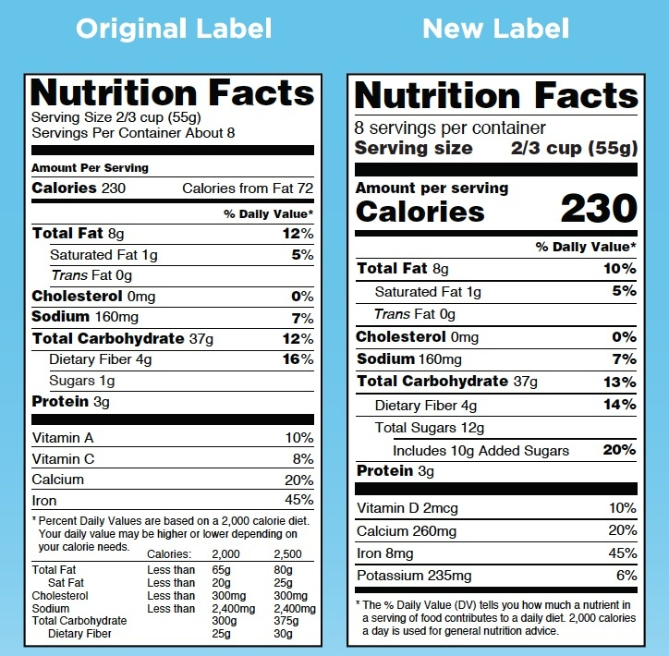
Label Reading
1. Note the serving size and the number of servings.
2. Look at the Total Carbohydrates, NOT Sugar.
Notes:
ADA recommends using total grams of carbohydrates and closely monitoring blood sugars when consuming foods high in fiber or sugar alcohol to determine affect
“net carbs” not recognized by the ADA.
The contribution of fibers to total cho depends on types present which is not indicated on nutrition facts label
Sugar alcohols = ~1/2 the calories of regular sugar
Added sugar. Per healthychildren,org aim for less than 25 grams (6 teaspoons) added sugar per day for children 2 years and older

Slide 13
Are all carbohydrates considered equal?

Slide 14
Types of Carbohydrates
Types of carbs
  Sugar
  Fiber
  Starch
Simple versus complex
Simple
Refined
Complex
Whole grains
Candy
Desserts
Sweetened beverages
Starchy vegetables
Legumes
Natural
Table sugar
Fruit
Milk
Notes:
Starch
Fiber
Only in plants
Acts like your body’s natural scrub brush
Keeps us full and helps lower cholesterol
Sugar
Complex carb
Contain both starch and fiber
Nutrient dense
Keep blood glucose balanced and steady
Simple carb
Refined
Breakdown more quickly
Tend to have a greater impact on blood glucose
Highly processed and have fewer nutritional benefits

Slide 15
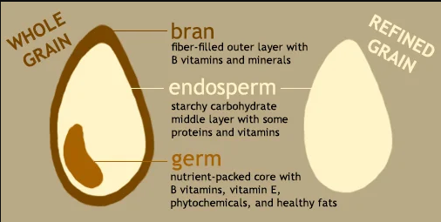
Glycemic Impact
Glycemic Index - measure of how fast and how much a food raises your blood sugar level
  Ranked on a scale of 0 to 100 (glucose)
Many factor can affect the GI of food
  Acidity
  Cooking time
  Food combinations
  Processing level
  Fiber content
  Amount of the food
Conflicting evidence on overall benefits
Notes:
The glycemic index (GI) assigns a numeric score to a food based on how drastically it makes your blood sugar rise. Foods are ranked on a scale of 0 to 100, with pure glucose (sugar) given a value of 100.
Kirpitch et
Studies have shown that diets with more low versus high GI foods may improve glycemic control
al

Slide 16
Carbohydrates are not the only nutrient to affect blood sugars.

Slide 17
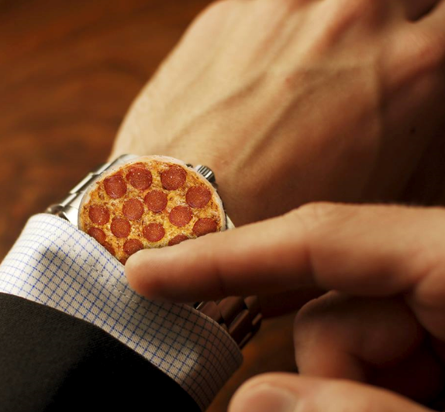
Other Factors to Consider - Fat
Meals containing carbohydrates and high fat cause sustained late postprandial hyperglycemia
Delayed gastric emptying
  Delays rise in blood glucose
Impaired insulin sensitivity
Notes:
-Increases in mealtime insulin doses for high fat meals need to be individualized
For high fat meals (<40g), consider additional 30-35%
-if CSII – 50% before eating and 50% over 2-2.5 hours
-if MDI, administer additional insulin 1 hour after the meal
Bell et al
Evert et al

Slide 18
Other Factors to Consider - Protein
People with type 2 diabetes and without diabetes
  Protein can stimulate insulin response without increasing glucose
People with type 1 diabetes
  Protein can contribute to postprandial hyperglycemia and increase insulin requirement
Different effects when consumed with and without carbohydrates
  Protein only meal
    Up to 50 grams protein did not significantly affect glycemia
    >75 grams significantly increased glucose starting at 100 minutes with a peak at 5 hour
  Protein with carbohydrates
    Increased glucose ranged from 90-240 minutes
    >12.5 g of protein affected postprandial glucose
    Multiple studies demonstrate increased insulin demand for high protein meals however
    Studies also show individual responses vary
  Protein can protect against hypoglycemia
Notes:
Paterson, M.A., King, B.R., Smart, C.E.M., Smith, T., Rafferty, J., & Lopez, P.E. (2019, December). Impact of dietary protein on postprandial glycaemic control and insulin requirements in Type 1 diabetes: A systematic review. Diabetic Medicine, 36(12), 1585-1599. https://doi.org/10.1111/dme.14119
Glycemic excursion following 75 g protein was similar to 20g of glucose (without insulin). Slower rise 90-100 minutes versus spike in first 30 minutes of 20g glucose
Studies adjusting insulin
HF/HP meal required 30% more insulin than LF/LP
60g protein meal required 50% more insulin compared with meal of only 5.7 grams protein. ½ of additional insulin required to be delivered in first 2 hours
65% more insulin delivered using split bolus over 3 hours
Evert, A.B. (2020, May). Factors Beyond Carbohydrate to Consider When Determining Meantime Insulin Doses: Protein, Fat, Timing, and Technology. Diabetes spectrum : A publication of the American Diabetes Association, 33(2), 149-155. https://doi.org/10.2337/ds20-0004
Studies have shown increase incidence of hypoglycemia following LF/LP meal. Significant reduction in the odds of hypoglycemia following high protein meal compared with a low protein meal

Slide 19
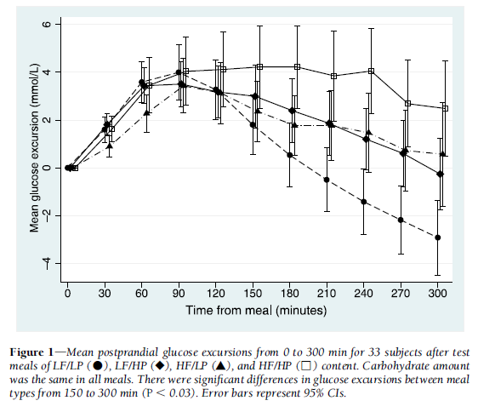
Other Factors to Consider – Fat + Protein
The effect of fat and protein was additive
Further delays and extends the postprandial glycemic response
Significantly higher glycemic excursions for the HP and HF meals
Notes:
Smart et al.
Paterson et al
Studies comparing impact of HF/HP with LF/LP, where insulin only given for cho content, show prolonged and sustained postprandial hyperglycemia from 3-12 hours
1 proposed m ethod to calculate additional insulin: 100kcal of fat and/or protein requires same amount of insulin as 10grams of cho
Uthoff, H., Lehmann, R., Sprenger, M., & Wiesli, P. (2010, May). Skipping Meals or Carbohydrate-Free Meals in Order to Determine Basal Insulin Requirements in Subjects with Type 1 Diabetes Mellitus?. Experimental and Clinical Endocrinology & Diabetes, 118(05), 325-327. https://doi.org/10.1055/s-0029-1241199

Slide 20
Wait, what??? Saturated fats cause insulin resistance…

Slide 21
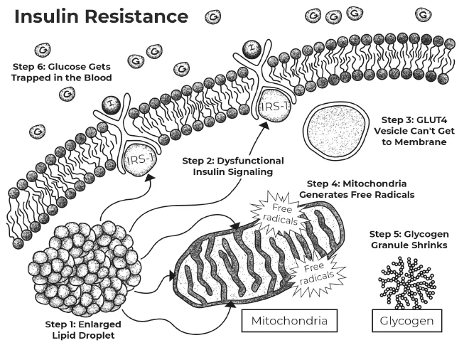
Fat and Insulin Resistance
-Studies in the late 90’s via MRI’s started to show that diets high in saturated fats can cause fat particles to build up inside our cells (muscle and liver cells)
-Fat particles interfere with insulin’s ability to attach to the cell (it “gums” up the lock!)
-Fat impedes insulin signaling mechanism
…therefore glucose is “locked out” of the cell and builds up in the blood, leading to high blood sugars!
Graphic courtesy of “Mastering Diabetes”
Notes:
It is fat composition rather than the total amount of fat that really matters!!
-Insulin sensitivity is affected by quality of dietary fat
Epidemiological evidence and intervention studies show in humans saturated fat significantly worsen insulin resistance
mono and polyunsaturated fatty acids improve it through modifications in the composition of cell membranes
Several cross-sectional studies have shown a positive association between saturated fat intake and hyperinsulinaemia
Increased unsaturated fat intake is associated with improved insulin sensitivity
Specific fatty acids profile in cell membranes could influence insulin action through several potential mechanisms, including altered insulin receptor binding or affinity and by influencing ion permeability and cell signaling

Slide 22
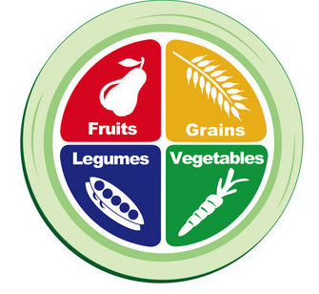
Diet to improve insulin resistance
Whole-food, plant-based diet shown to improve insulin sensitivity
Focus on
  Fruits
  Vegetables
  Legumes
  Whole grains
Limits
  Saturated fats
  Processed foods
  Added sugars
PCRM.org

Slide 23
Snacks count too.

Slide 24
Snacks and extra food
Snacks affect blood sugar levels too!
Amount of carbs that you need to cover varies depending on; honeymoon, ICR, size of snack, activity etc.
If it has been less than 3-4 hours since last rapid acting insulin injection do not have to test. Cover only carbohydrates eaten.
  Example: 45 minutes after dinner child has a piece of cake that was not included in dinner shot.
Do not eliminate snacks/use only low carb foods to avoid shots. Body needs the energy to grow!

Slide 25

Timing does matter.

Slide 26
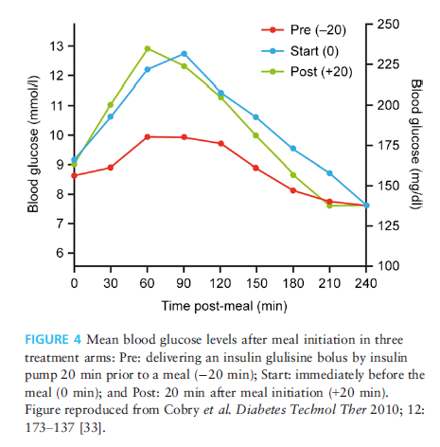
Benefits of giving insulin before eating
Reduction in post-meal glucose when prebolusing 20 minutes before meals
Another study found that patients missed more bolus in post meal administration
Prebolusing may not be appropriate for everyone:
  Lower pre meal blood sugars (<80 mg/dL)
  Unpredictable meal intakes
  High fat meals

Slide 27
Key points from Standards of Care in Diabetes
There is no ideal macronutrient pattern for people with diabetes; meal plans should be individualized while keeping nutrient quality, total calorie, and metabolic goals in mind.
There is not a “one-size-fits-all” eating pattern for individuals with diabetes, and meal planning should be individualized

Slide 28
Key Points to Remember
Healthy food choices are important for those living with diabetes… and for ALL humans!
Carbohydrates are important!
Medical nutrition therapy and care plan should be individualized.
  Calories, carbs and portions do not have to meet certain “prescribed” amounts. Amount is determined by child’s hunger and appetite.
Insulin is then matched to child’s carbohydrate intake, before if possible, if not after the meal.

Slide 29
References
Smart, C.E., Evans, M., O'Connell, S.M., McElduff, P., Lopez, P.E., Jones, T.W., Davis, E.A., & King, B.R. (2013, December 1). Both Dietary Protein and Fat Increase Postprandial Glucose Excursions in Children With Type 1 Diabetes, and the Effect Is Additive. Diabetes Care, 36(12), 3897-3902. https://doi.org/10.2337/dc13-1195
Bell, K.J., Toschi, E., Steil, G.M., & Wolpert, H.A. (2016, September). Optimized Mealtime Insulin Dosing for Fat and Protein in Type 1 Diabetes: Application of a Model-Based Approach to Derive Insulin Doses for Open-Loop Diabetes Management. Diabetes Care, 39(9), 1631-1634. https://doi.org/10.2337/dc15-2855
Evert, A.B. (2020, May). Factors Beyond Carbohydrate to Consider When Determining Meantime Insulin Doses: Protein, Fat, Timing, and Technology. Diabetes spectrum : A publication of the American Diabetes Association, 33(2), 149-155. https://doi.org/10.2337/ds20-0004
Bell, K.J., Smart, C.E., Steil, G.M., Brand-Miller, J.C., King, B., & Wolpert, H.A. (2015, June). Impact of fat, protein, and glycemic index on postprandial glucose control in type 1 diabetes: Implications for intensive diabetes management in the continuous glucose monitoring era. Diabetes care, 38(6), 1008-15. https://doi.org/10.2337/dc15-0100
Paterson, M.A., King, B.R., Smart, C.E.M., Smith, T., Rafferty, J., & Lopez, P.E. (2019, December). Impact of dietary protein on postprandial glycaemic control and insulin requirements in Type 1 diabetes: A systematic review. Diabetic Medicine, 36(12), 1585-1599. https://doi.org/10.1111/dme.14119
Evert, A.B. (2020, May). Factors Beyond Carbohydrate to Consider When Determining Meantime Insulin Doses: Protein, Fat, Timing, and Technology. Diabetes spectrum : A publication of the American Diabetes Association, 33(2), 149-155. https://doi.org/10.2337/ds20-0004
Uthoff, H., Lehmann, R., Sprenger, M., & Wiesli, P. (2010, May). Skipping Meals or Carbohydrate-Free Meals in Order to Determine Basal Insulin Requirements in Subjects with Type 1 Diabetes Mellitus?. Experimental and Clinical Endocrinology & Diabetes, 118(05), 325-327. https://doi.org/10.1055/s-0029-1241199
Kirpitch, A.R., & Maryniuk, M.D. (2011, October 1). The 3 R's of Glycemic Index: Recommendations, Research, and the Real World. Clinical Diabetes, 29(4), 155-159. https://doi.org/10.2337/diaclin.29.4.155
American Diabetes Association Professional Practice Committee, American Diabetes Association Professional Practice Committee:, Draznin, B., Aroda, V.R., Bakris, G., Benson, G., Brown, F.M., Freeman, R., Green, J., Huang, E., Isaacs, D., Kahan, S., Leon, J., Lyons, S.K., Peters, A.L., Prahalad, P., Reusch, J.E.B., Young-Hyman, D., Das, S., & Kosiborod, M. (2022, January 1). 5. Facilitating Behavior Change and Well-being to Improve Health Outcomes: Standards of Medical Care in Diabetes-2022. Diabetes care, 45(Suppl 1), S60-S82. https://doi.org/10.2337/dc22-S005
Diabetes.org
Chen, Z., Zuurmond, M.G., van der Schaft, N., Nano, J., Wijnhoven, H.A.H., Ikram, M.A., Franco, O.H., & Voortman, T. (2018). Plant versus animal based diets and insulin resistance, prediabetes and type 2 diabetes: The Rotterdam Study. European Journal of Epidemiology, 33(9), 883-893. https://doi.org/10.1007/s10654-018-0414-8
Riccardi, G., Giacco, R., & Rivellese, A.A. (2004, August). Dietary fat, insulin sensitivity and the metabolic syndrome. Clinical Nutrition, 23(4), 447-456. https://doi.org/10.1016/j.clnu.2004.02.006
Goode, J.P., Smith, K.J., Breslin, M., Kilpatrick, M., Dwyer, T., Venn, A.J., & Magnussen, C.G. (2023, May). A Healthful Plant-Based Eating Pattern Is Longitudinally Associated with Higher Insulin Sensitivity in Australian Adults. The Journal of nutrition, 153(5), 1544-1554. https://doi.org/10.1016/j.tjnut.2023.03.017
Sears, B., & Perry, M. (2015, September 29). The role of fatty acids in insulin resistance. Lipids in Health and Disease, 14(1), 121. https://doi.org/10.1186/s12944-015-0123-1
PCRM.org

