Slide 1
Navigating the Ever Changing Landscape of Pediatric Type 2 Diabetes
What we knew then and what we know now…..
Geneva Foncannon RD, CDCES
Marisa Salas-Silva LCSW

Slide 2
Progression of Type 2 Diabetes in Pediatrics
No Diabetes
Increasing Risk
Pre-Diabetes
Type 2 Diabetes
-A1c <5.7
-FBG < 100 mg/dl
-Sedentary lifestyle
-Family history of T2D or mom with GDM
-Where you live
-Access to healthy food
-African-American, Asian, Hispanic
-Female
-A1c 5.7-6.4
-FBG 100-125 mg/dl
-Presence of Acanthosis Nigricans
-Continued increase in weight
-often goes undiagnosed and untreated
-A1c 6.5 or >
-FBG >126 mg/dl
-Common comorbidities at time of diagnosis: hyperlipidemia, fatty liver, HTN, PCOS
Notes:
-Diagnostic criteria is currently the same as for adults, but there are limitations and more research is needed to develop pediatric specific screening and diagnostic criteria
-”Social determinants of Health” (conditions and environment into which we are born/live/work/play) are drivers of chronic metabolic conditions (income, education, housing/neighborhood, access to nutritious food, access to health care) are central to development of T2D

Slide 3
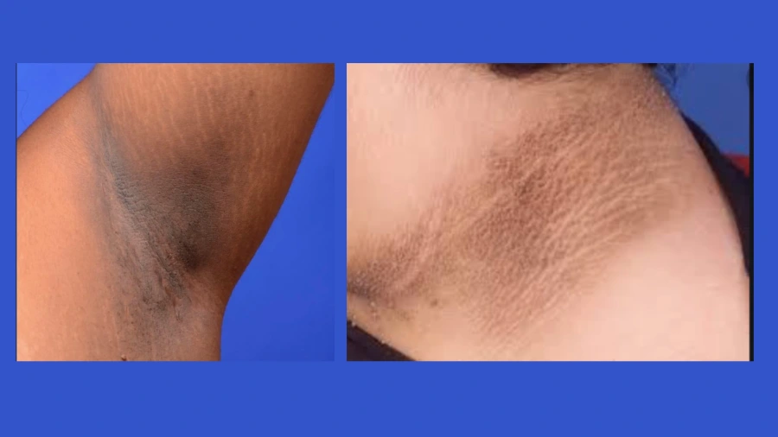
Acanthosis Nigricans

Slide 4
Progression of Type 2 Diabetes in Pediatrics
No Diabetes
Increasing Risk
Pre-Diabetes
Type 2 Diabetes
-A1c <5.7
-FBG < 100 mg/dl
-Sedentary lifestyle
-Family history of T2D or mom with GDM
-Where you live
-Access to healthy food
-African-American, Asian, Hispanic
-Female
-A1c 5.7-6.4
-FBG 100-125 mg/dl
-Presence of Acanthosis Nigricans
-Continued increase in weight
-often goes undiagnosed and untreated
-A1c 6.5 or >
-FBG >126 mg/dl
-Common comorbidities at time of diagnosis: hyperlipidemia, fatty liver, HTN, PCOS

Slide 5
Pediatric Type 2 Diabetes What we knew then…
<1% of our practice population had T2D 20 years ago
No treatment consensus from the endocrine medical community, wasn’t recognized as a childhood disease until about 10 years ago
Some signs of metabolic syndrome already present at diagnosis
Restricted carbohydrate diet advised based upon calculated calorie restricted diet using the ADA “Exchange Method”
Only 2 treatment options approved in pediatrics other than lifestyle intervention: metformin and insulin
high “no show” rate for these patients/families to clinic

Slide 6
Pediatric Type 2 Diabetes What we know now…
Approximately 15% of our practice population has T2D
Rate of new cases of T2D increased 4.8% between 2002-2015 in the USA (SEARCH Study)
Racial disparities deepen with greater proportion of POC being diagnosed with T2D
Kids often present “sicker” to the ER with ketones, pancreatitis, and metabolic decompensation
77% increase in diagnosis of T2D in youth between 8-21 years old from the 2 years pre-pandemic to the first year of the pandemic (Johns Hopkins University School of Medicine)
Expanding treatment options in the last year (metformin, insulin, GLP-1 agonist) in addition to lifestyle modification

Slide 7

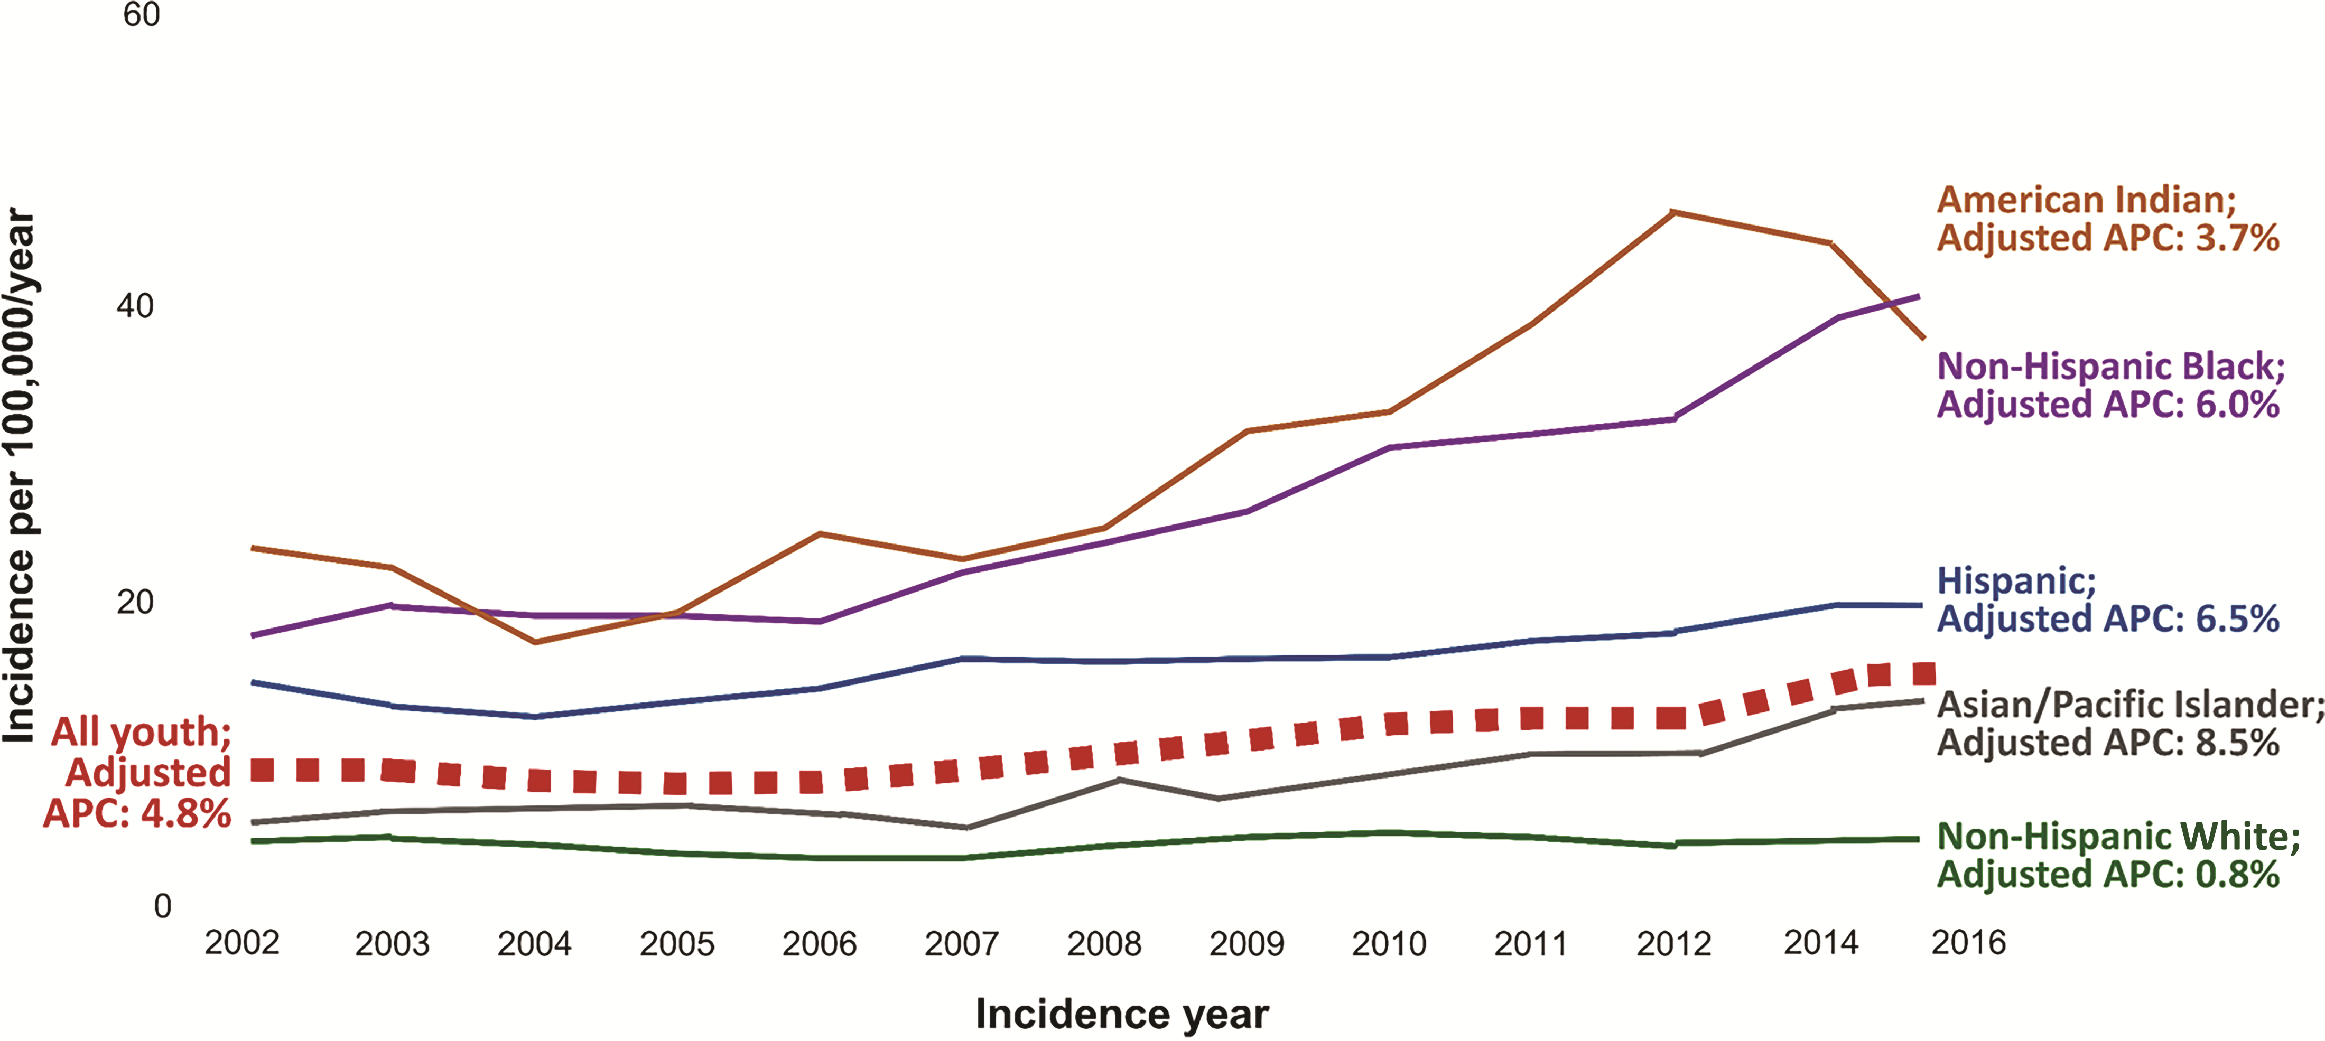
From: Youth-Onset Type 2 Diabetes: The Epidemiology of an Awakening Epidemic
Diabetes Care. 2023;46(3):490-499. doi:10.2337/dci22-0046
Figure Legend:
Temporal trends and APC in incidence of type 2 diabetes among multiethnic U.S. youth in the SEARCH study from 2002 to 2015. APC estimates for all youth are adjusted for age, sex, race, and ethnicity; estimates within racial and ethnic strata are adjusted for age and sex. Created from data reported in Mayer-Davis et al. (15) and Divers et al. (6).
Date of Download: 9/11/2023
Copyright © 2023 American Diabetes Association. All rights reserved.
Notes:
-SEARCH study (population based study that surveilled physician diagnosed diabetes in Washington, South Carolina, Ohio, Colorado, and California, plus select American Indian reservations, from 2000-2020)
-APC = annual percent change
-Based researchers project a fourfold increase in prevalence of pediatric T2D in the USA by 2050

Slide 8
Pediatric Type 2 Diabetes What we know now…
Approximately 15% of our practice population has T2D
Rate of new cases of T2D increased 4.8% between 2002-2015 in the USA (SEARCH Study)
Racial disparities deepen with greater proportion of POC being diagnosed with T2D
Kids often present “sicker” to the ER with ketones, pancreatitis, and metabolic decompensation
77% increase in diagnosis of T2D in youth between 8-21 years old from the 2 years pre-pandemic to the first year of the pandemic (Johns Hopkins University School of Medicine)
Expanding treatment options in the last year (metformin, insulin, GLP-1 agonist) in addition to lifestyle modification

Slide 9
Pediatric Type 2 Diabetes What we know now…continued
Nutrition focus shifting recommendations to improve insulin resistance with plant based/low fat diet versus overt carbohydrate restriction
Diagnosis during puberty increases insulin resistance
More rapid decline in beta cell function with accelerated progression of complications than adults with T2D (TODAY study)
Pediatric T2D is associated with higher rates of complications than T1D (SEARCH study)
60% prevalence of having any microvascular complication (retinopathy, peripheral neuropathy, nephropathy) within 13 years of diagnosis (TODAY study)
Often perceived as the “better kind of diabetes to have” without a sense of family urgency to manage glucose levels
Delay in diagnosis/Missed diagnosis
Notes:
-TODAY study (Treatment Options for T2D in Adolescents and Youth) = a US clinical trial assessing treatment efficacy among youth with recently diagnosed T2D

Slide 10
Current Management of T2D in pediatrics …working as a team together!
Medical management initiated by endocrinologist following ADA Standards of Care American Diabetes Association, 14. Children and adolescents: Standards of Care in Diabetes-2023. Diabetes Care 2023;46(Suppl. 1): S230-S253
Shared decision making between child, family and health care provider
Explore cultural belief systems together about food and medicine with consideration of access to food choices
Focus efforts on limiting processed carbs/high fat foods and lean into whole food plant based choices to reduce insulin resistance
Find opportunities to be physically active most days of the week (goal >60 minutes) also to include strength training 3 days/week
Screening for mental health concerns, BP, sleep apnea, kidney disease, hyperlipidemia
Multidisciplinary approach involving healthcare providers, teachers, daycare providers, community support and advocacy at every level to do better for our future generation…it will take us all!

Slide 11
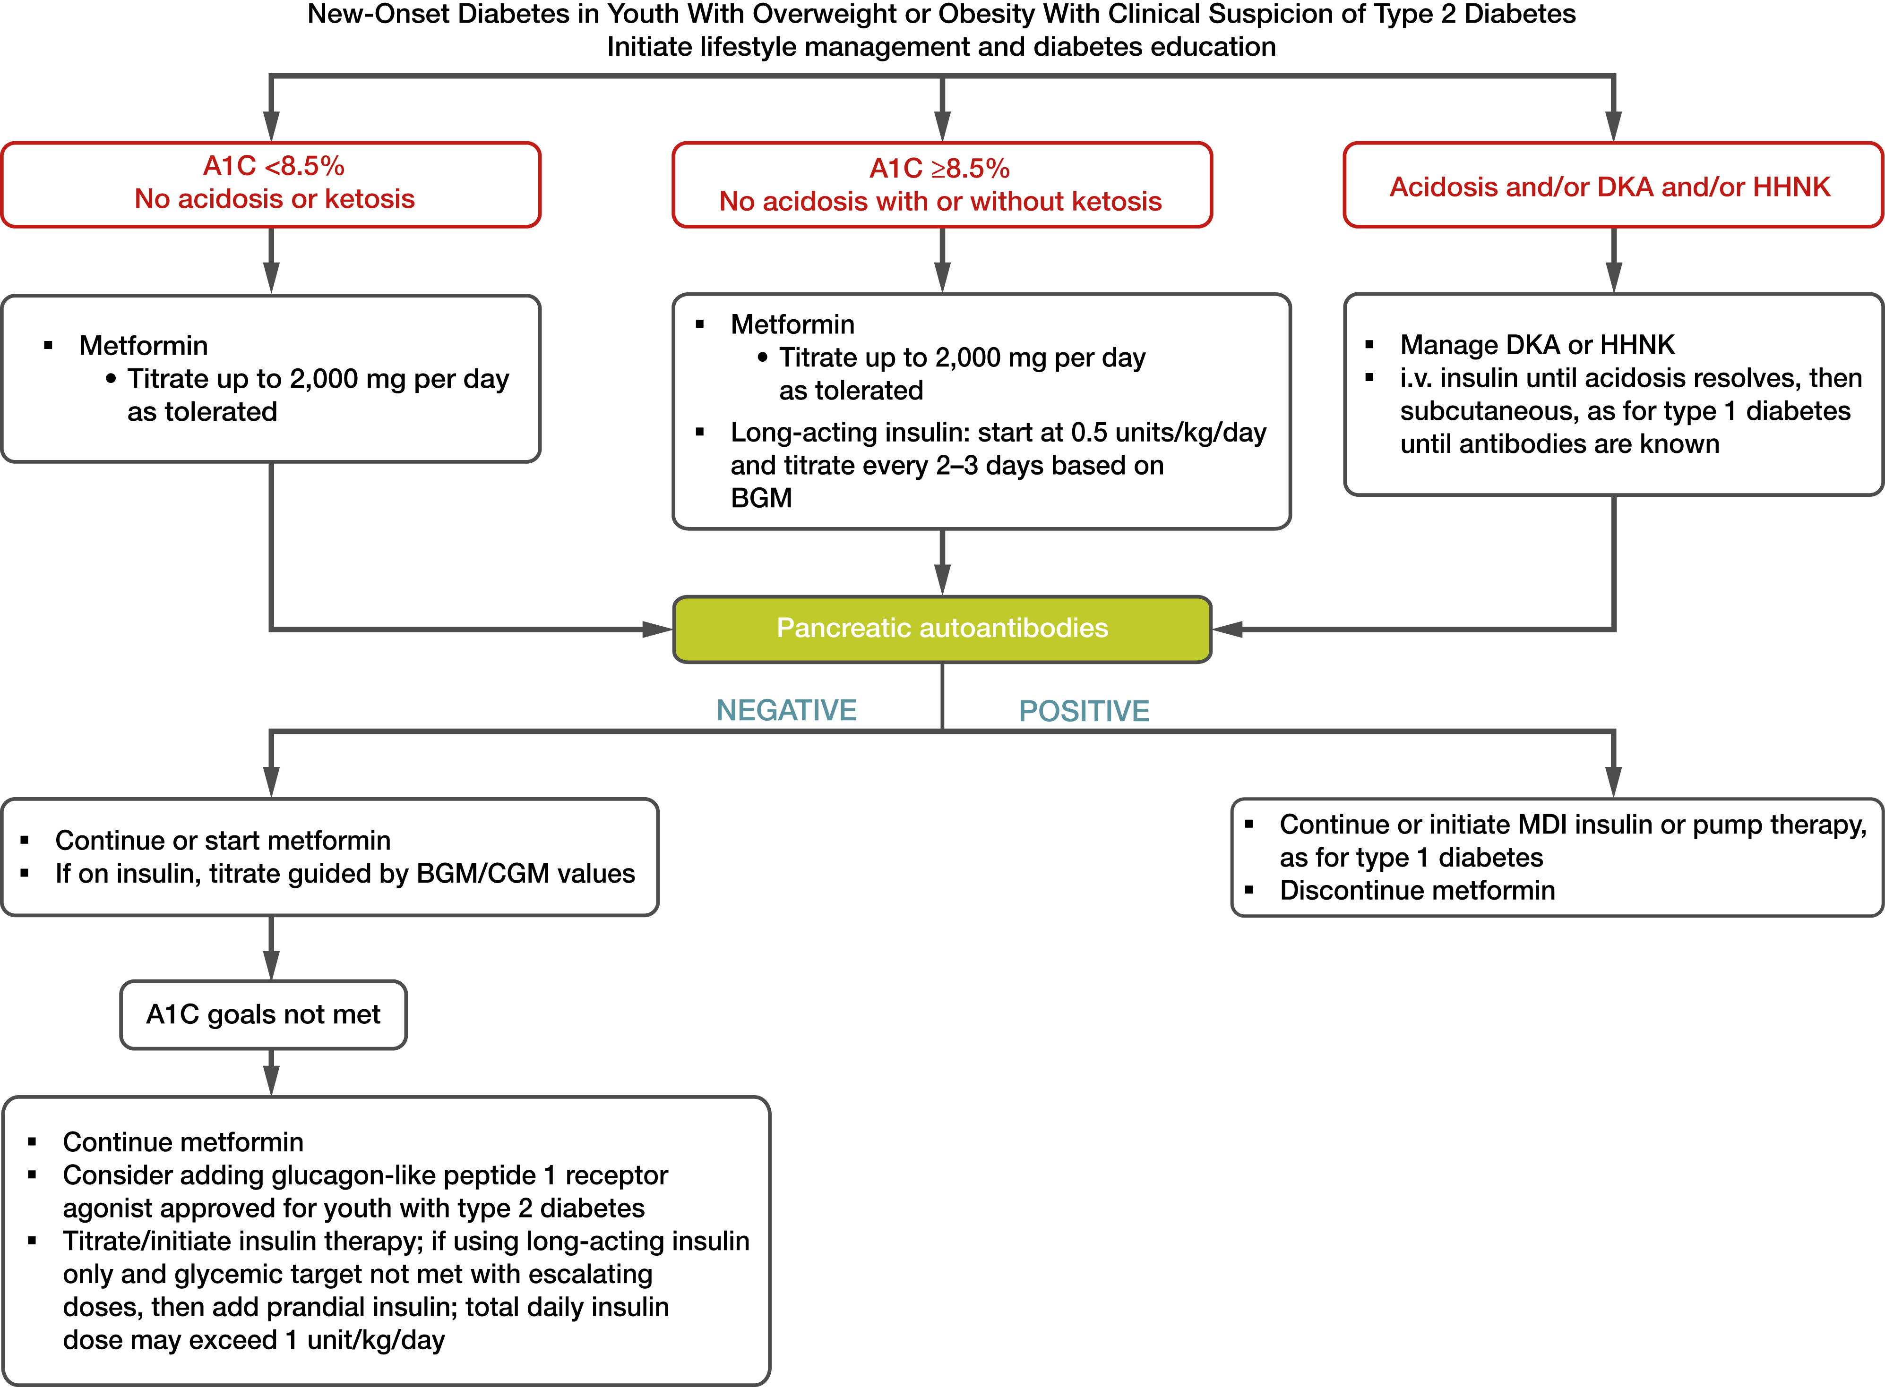
From: 14. Children and Adolescents: Standards of Care in Diabetes—2023
Diabetes Care. 2022;46(Supplement_1):S230-S253. doi:10.2337/dc23-S014
Figure Legend:
Management of new-onset diabetes in youth with overweight or obesity with clinical suspicion of type 2 diabetes. A1C 8.5% = 69 mmol/mol. Adapted from the ADA position statement “Evaluation and Management of Youth-Onset Type 2 Diabetes” (3). BGM, blood glucose monitoring; CGM, continuous glucose monitoring; DKA, diabetic ketoacidosis; HHNK, hyperosmolar hyperglycemic nonketotic syndrome; i.v., intravenous; MDI, multiple daily injections.
Date of Download: 9/6/2023
Copyright © 2023 American Diabetes Association. All rights reserved.

Slide 12
Medication algorithm, made easy-ish!
Start Metformin with A1c<8.5% initially, asymptomatic
Start basal insulin and metformin with A1c>8.5% initially with symptoms
If unable to get A1c<7%, start GLP-1 in children >10 years old
If unable to get A1c<7% with Metformin, basal insulin and GLP-1, consider prandial insulin, either multiple daily injections/pump
Notes:
-GLP-1 work to enhance insulin release and reduce glucagon release, cause reduced appetite and delayed glucose absorption due to slower gastric emptying
-Metformin decreases the amount of blood sugar that the liver produces and that the stomach or intestines absorb

Slide 13
Current Management of T2D in pediatrics …working as a team together!
Medical management initiated by endocrinologist following ADA Standards of Care American Diabetes Association, 14. Children and adolescents: Standards of Care in Diabetes-2023. Diabetes Care 2023;46(Suppl. 1): S230-S253
Shared decision making between child, family and health care provider
Explore cultural belief systems together about food and medicine with consideration of access to food choices
Focus efforts on limiting processed carbs/high fat foods and lean into whole food plant based choices to reduce insulin resistance
Find opportunities to be physically active most days of the week (goal >60 minutes) also to include strength training 3 days/week
Screening for mental health concerns, BP, sleep apnea, kidney disease, hyperlipidemia
Multidisciplinary approach involving healthcare providers, teachers, daycare providers, community support and advocacy at every level to do better for our future generation…it will take us all!

Slide 14
Where do we go from here???
We need to better understand the pathophysiology of pediatric T2D so that we can develop better screening to identify high risk youth and focus on prevention…research, research, research and fast!
We need focused efforts from the government, private sector, public health specialists and clinicians to work together at all levels
Notes:
-promote healthy nutritional and agricultural policies
-implement modifications in our environment that encourage physical activity
-prevention strategies need to be affordable and accessible to our most high risk and vulnerable populations and deployed at the community level with the help of the public health sector
-clinicians involved in screening and identifying high risk youth and connecting to intervention programs (not many of these currently exist!)
***a concerted effort across all of these sectors is necessary to develop and test cost-effective community level interventions that not only meet individual needs, but also ensure that they are effective/sustainable and easily accessible to our most vulnerable population over the long term***

Slide 15

Let’s do better together for our kids...our future depends on it!

Slide 16
References/Resources
Diabetes Care 2023;46(Suppl. 1):S230-S253 | https://dor.org/10.2337/dc23-S014
https://today.bsc.gwu.edu/home
https://www.searchfordiabetes.org/dspHome.cfm
https://hopkinsmedicine.org/news/newsroom/news-releases/significant-boost-in-rates-of-type-2-diabetes-among-children-during-covid-19-pandemic
https://www.healthline.com/health-news/why-the-youngest-type-2-diabetes-patients-are-the-sickest
www.pcrm.org/health-topics/diabetes
www.masteringdiabetes.org
Wei Perng, Rebecca Conway, Elizabeth Mayer-Davis, Dana Dabelea; Youth-Onset Type 2 Diabetes: The Epidemiology of an Awakening Epidemic. Diabetes Care 1 March 2023; 46 (3): 490–499. https://doi.org/10.2337/dci22-0046

Slide 17
Let’s Challenge Our Bias!

Slide 18
We all have bias…. even health care professionals Let’s focus on weight bias:
Weight Bias “is defined as negative weight related attitudes, beliefs, assumptions and judgements towards individuals who are overweight and obese.” Can be with both low and high weights.
One research study completed a cross-sectional review of 41 studies to assess if there is a relationship between view held by healthcare professionals impacting patient provider relationship negatively. Findings indicated multiple health care professionals demonstrate implicit and/or explicit weight bias toward people living with overweight or obesity. Some of the health care professionals listed include:
medical doctors, nurses, dietitians, psychologists, physiotherapists, occupational therapist, speech pathologists, podiatrists, and exercise physiologists.
Washington RL. Childhood Obesity: issues of weight bias. Preventing Chronic disease. 2011. http://www.cdc.gov/pcd/issues/2011/sep10_0281.htm
Russell-Mayhew S, Ranson, M. Von Ranson K, McLaren L, Alberga, A; Weight bias: a call to action. Journal of Eating Disorder 92016) 4:34 DOI 10.1186/s40337-016-0112-4

Slide 19
“Numerous studies show that children and adults living with obesity are treated unequally because of their size at school, work, in interpersonal relationships and within healthcare system.”
Puhl RM, Heuer CA. The stigma of obesity; a review and update. Obesity (Silver Spring). 2009;17 (5):941-64. doi:10.1038/oby.2008.636.
“Although more research is needed on root causes of weight bias, one of the casual explanations for having weight-biased attitudes is holding the belief that obesity is “controllable” by the individual.”
Crandall R, Reser. A. Attributions and weight based prejudice. In: Brownell K, Puhl R, Schwartz M, Rudd L, editors. Weight bias: nature, consequences and remedies. New York: Guilford Press; 2005.
“Several national organizations have recognized obesity as a chronic disease supported by research evidence that there is a genetic basis an complexity of obesity that lies beyond individual.”
Pollack A A.M.A. Recognizes obesity as a disease. 2015 [Internet Retrieved March 2, 2016: http://www.nytimes.com/2013/06/19/business/ama-recognizes -obesity-as-a-disease.html.

Slide 20
What are we noticing…..
Impact on Care
Observations in PENS Clinic regarding weight bias
less engaged during appointments and decreased use of healthcare services
cancellation of appointments if anticipated needing to be weighed
delaying examinations because of fears of judgement when needing to expose body
Tomiyama AJ, Carr D, Granberg EM, et al. How and why weight stigma drives the obesity ‘epidemic’ and harms health. BMC Med. 2018;16(1):123.doi.1186/s12916-018-1116-5
Wu YK, Berry DC. Impact of weight stigma on physiological and psychological health outcomes for overweight and obese adults: a systematic review. J Adv Nurs. 2018;74(5):1030-1042
Padadopoulos S, Brennan L. Correlates of weight stigma in adults with overweight and obesity; a systematic literature review. Obesity (Silver Spring). 2015;23(9)1743-1760
Not wanting to dress down for physical education
Hesitant for physical education as might not be as active as peers
Self conscious of where to give injections
Shame around diagnosis and telling friends

Slide 21
Adverse Health Consequences: Puhl RM, Heuer CA. The stigma of obesity; a review and update. Obesity (Silver Spring). 2009;17 (5):941-64. doi:10.1038/oby.2008.636. Pearl RL, White MA, Grilo CM. Weight bias internalization, depression and self-reported health among overweigh binge eating disorder patient. Obesity (Silver Spring). 2014;22 (5): E142-8, doi:10.1002/oby.20617. Pearl RH, White MA, Grilo CM. Overevaluation of shape and weigh as a mediator between self-esteem and weight bias internalization among patient’s with binge eating disorder. Eat Behav. 2014; 1592):259-61. doi;10.1016/jeatbeh.2014.03.005.
Anxiety
Stress
Depression
Low self-esteem
Body Image Issues
Consequences more associated with stigma versus the weight itself
Eating disorders

Slide 22
Trauma Informed Care Trauma comes in many forms…including medical
Diagnosis
Hospitalization
Lab work
Low blood sugar
Injections
Poking fingers
Medical exams that feel invasive
Experience of bias, weight bias, etc.

Slide 23
Trauma Informed care is defined as practices that promote a culture of safety, empowerment, and healing
Trauma informed care which has 6 principals
1.Safety
2. Trustworthiness and Transparency
3.Peer Support
4.Collaboration and Mutuality
5.Empowerment Voice and Choice
6.Cultural, Historical, and Gender Issues SAMHSA, 2014.

Slide 24
Practical Interventions: Translating Research Into Practice Biber and Ella. Journal of Health Psychology 24,14 (2019):2060-2071 Speight, et al. Diabetes Res Clin Pract. 2012;97 93); 425-431 Thomasian, B 92021); How to Success with Person-Centered Coaching https://diabetes.net/how-to-succeed-with-person-centered-coaching/
Neutral Language:
Use language based in fact not judgement
Patient-Centered Care:
-focus on strengths
-listen without fixing
-ask more questions

